Slide 1


Slide 2
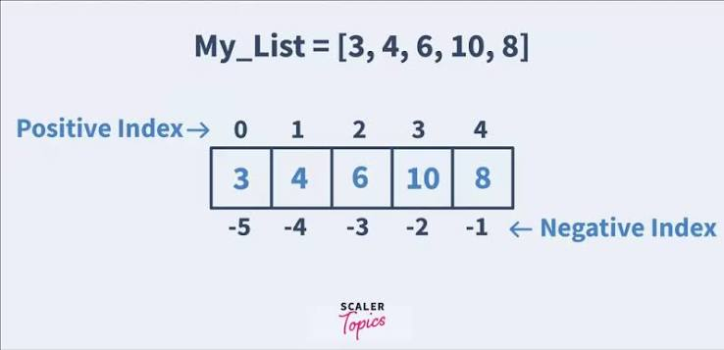
LIST IN PYTHON
A List is a collection of multiple items stored in a single variable.
Lists are ordered, changeable (mutable), and allow duplicate values.
Lists can store different data types such as integers, strings, and floats.
Lists are created using square brackets [ ].
Example:
fruits = ["Apple", "Banana", "Mango"]
print(fruits)

Slide 3
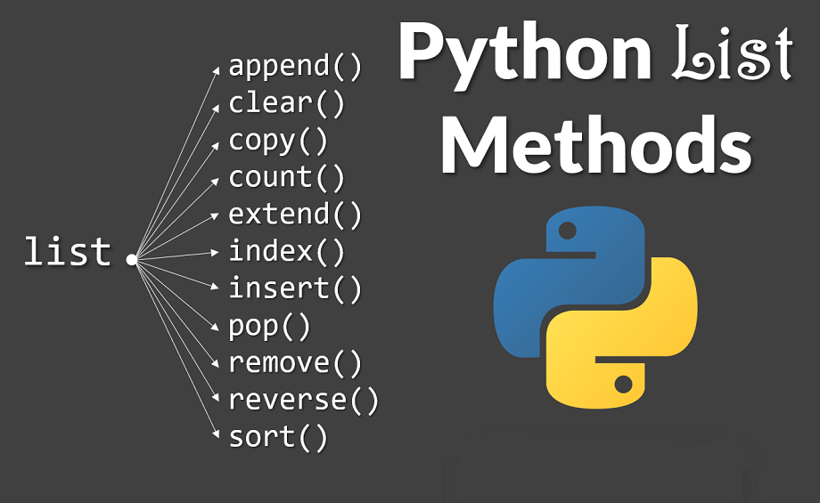
Common List Operations
Accessing Elements: Elements can be accessed using index numbers, starting from 0.
Adding Elements: append(), insert(), and extend() are used to add single or multiple elements.
Removing Elements: remove(), pop(), and clear() are used to delete elements from a list.
Updating Elements: Existing elements can be modified by assigning a new value to their index.
Finding Length: The len() function is used to find the total number of elements in a list.

Slide 4


List Features & Applications
Ordered: Elements are stored in a specific sequence and maintain their order.
Mutable: List elements can be added, removed, or modified after creation.
Allows Duplicates: The same value can appear multiple times in a list.
Multiple Data Types: A single list can contain integers, strings, floats, and other data types.
Indexing & Slicing: Elements can be accessed individually or as a range using indexes.

Slide 5
List Features & Applications
Storing Student Marks: Used to store and manage marks of multiple students.
Managing Names & Records: Useful for storing names, employee details, and other records.
Data Collection: Used to store and organize collections of related information.
Data Science & Machine Learning: Helps store and process datasets and input values.
Data Processing: Commonly used with loops for searching, sorting, filtering, and processing data.

Slide 6








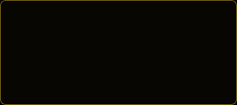



Meet the TUPLE
An ordered, immutable collection that groups related values.
CORE IDEA
TUPLE ANATOMY & INDEXING
One variable. Multiple related values.
Groups heterogeneous elements into a single unit.
student =
("Vamshi" ,
22,
"AI",
8.94)
(
index 0
index 1
index 2
index 3
)
ORDERED
Elements maintain their order and can be accessed by index.
Zero-indexed from left to right. Each position holds a fixed reference.
HOW A TUPLE IS CREATED
IMMUTABLE
Tuple elements cannot be added, removed, or reassigned.
1. BASIC SYNTAX
t
"A"
"B"
"C"
HETEROGENEOUS
Created with parentheses enclosing comma-separated values.
Different data types can coexist seamlessly in one tuple.
2. SINGLE ITEM
3. CONSTRUCTOR
t
5
✓ Tuple
x
5
✕ Integer
tuple
1
2
3
→ (1, 2, 3)
Fixed seuence model in Python memory
The comma creates the one-item tuple.
tuple() constructor builds tuple from any iterable.

Slide 7





Working with TUPLES
Access, inspect and combine values without changing the original tuple.
01 INDEXING
02 SLICING
t
"A"
"B"
"C"
"D"
t
0
# → "A" (First element)
t
1
# → "D" (Last element)
t
10
20
30
40
50
t
1
4
# → (20, 30, 40)
t
1
# → (50, 40, 30, 20, 10) (Reversed)
0
1
2
3
| | → (20, 30, 40)
-4
-3
-2
-1
Positive indexing starts at 0. Negative indexing starts at -1.
start : stop : step syntax returns a new tuple without modifying original.
03 OPERATORS
04 ITERATION
CONCATENATION
(1, 2) + (3, 4) → (1, 2, 3, 4)
for
in
t
print
REPETITION
(1, 2) * 2 → (1, 2, 1, 2)
MEMBERSHIP
2 in (1, 2, 3) → True
A B C D
Operators build fresh sequence objects; operands remain untouched.
Tuples are iterable and can be traversed using a for-loop.
ACCESS t[i] ✓
SLICE t[a:b] ✓
SEARCH item in t ✓
MODIFY t[i] = x ✕ (PROHIBITED)

Slide 8





Beyond the BASICS
TUPLE METHODS
t
count
# → Number of occurrences of value x
t
index
# → First matching index of value x
These are the only two built-in methods on Tuple objects.
BUILT-IN FUNCTIONS
len
t
# Length
min
t
# Minimum
max
t
# Maximum
sum
t
# Total sum
These are Python built-in functions, NOT Tuple methods.
SWAPPING
a
b
10
20
a
b
b
a
a: 10 → 20 | b: 20 → 10
MUTABILITY NUANCE
NESTED TUPLES
t
1
2
3
t
0
append
4
# Result: ([1, 2, 4], 3) ✓ Allowed
data
"A"
90
"B"
85
data
0
1
# → 90
Immutable tuple ≠ immutable objects inside it.
[0] accesses inner tuple, [1] accesses value.

Slide 9



The KEY DIFFERENCE: List vs Tuple
Both are ordered sequences. Mutability is the fundamental difference in memory and usage.
LIVE MUTATION TEST
PROPERTY | LIST [ ] | TUPLE ( )
Ordering | Ordered | Ordered
Mutability | Mutable (Can change) | Immutable (Cannot change)
Duplicates | Allowed | Allowed
Indexing & Slicing | Supported (0-indexed) | Supported (0-indexed)
Dictionary Key | Cannot be dict keys | Eligible if all elements hashable
Typical Use | Changing / dynamic collections | Fixed records / protected collections
LIST: [10, 20, 30]
numbers
0
100
# Result: [100, 20, 30]
TUPLE: (10, 20, 30)
numbers
0
100
# ✕ TypeError
TypeError: 'tuple' object does not support item assignment
LIST: [10, 20, 30] → [100, 20, 30] ✓ element can change
TUPLE: (10, 20, 30) → (10, 20, 30) 🔒 element cannot be reassigned
Rule of Thumb: Use a LIST when data changes. Use a TUPLE when data should stay fixed.

Slide 10
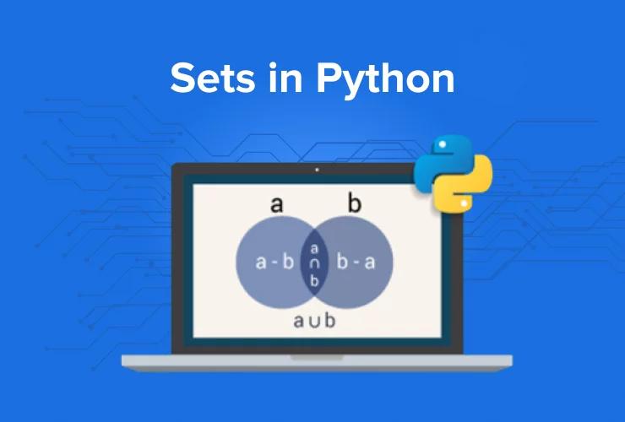
SETS
Introduction to Sets
Sets in Python
Unordered collection of unique elements
Created using { }
Duplicates values are removed automatically
Mutable — elements can be added or removed
Useful for unique data & mathematical set operations
List vs Sets
List
Ordered
Support Duplicate
Indexing(YES)
Sets
Unordered
No Duplicate
Indexing(NO)
numbers = {1, 2, 3, 3, 4}
print(numbers)
{1, 2, 3, 4}

Slide 11
Creating & Modifying Sets
Creating a Set:
Adding Multiple Elements:
fruits = {"apple", "banana", "orange"}
fruits.update(["grapes", "kiwi"])
Adding an Element:
Removing an Element:
fruits.add("mango")
fruits.remove("banana")
Important points:
Sets do not allow duplicate values.
Sets are unordered, so indexing like set[0] is not supported.
discard() can also remove an element without raising an error if it doesn't exist.
numbers = {1, 2, 3, 4}
numbers.discard(3)
print(numbers)
{1, 2, 4}

Slide 12
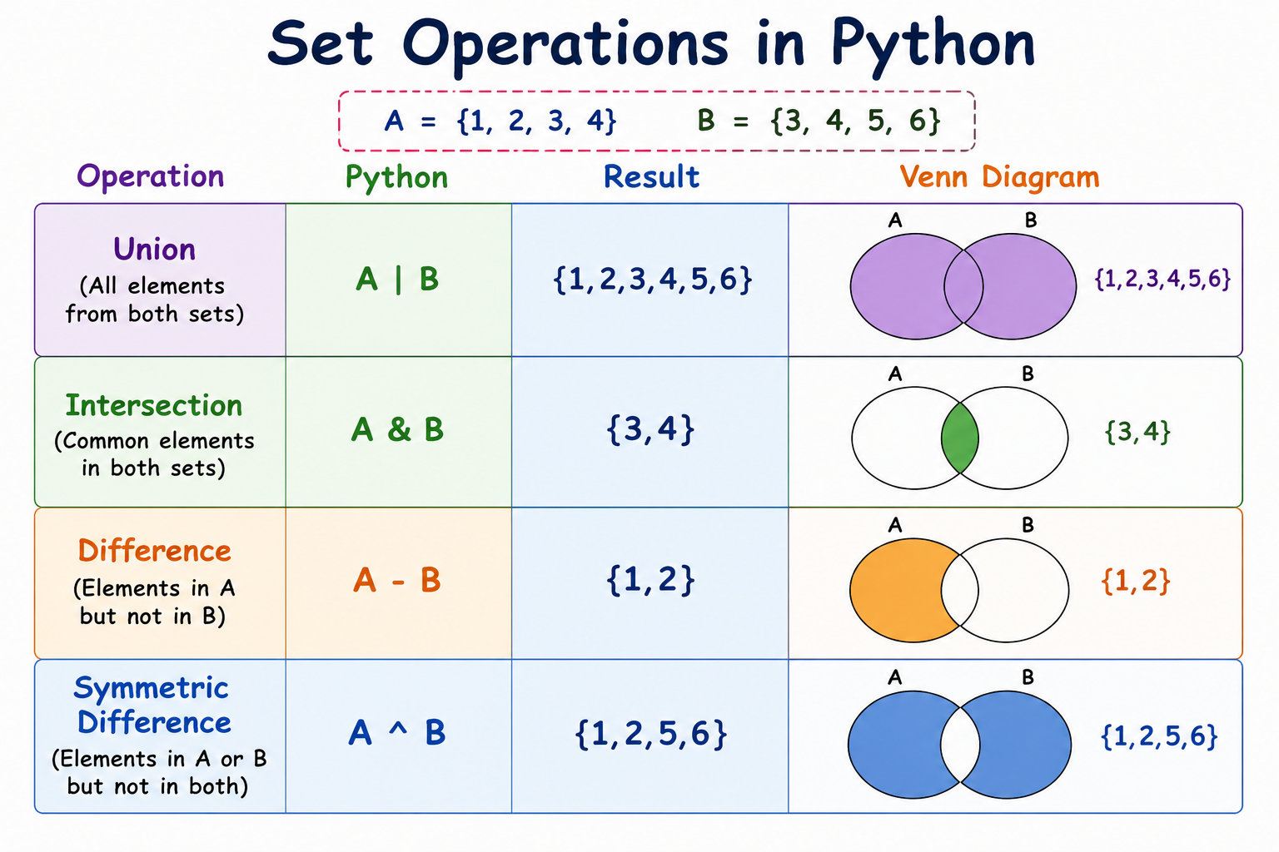
Set Operations
Advantages of Sets
Removes duplicates automatically.
Fast membership checking using in.
Disadvantages of Sets
No indexing or ordering like lists.
Can only store hashable (immutable) elements such as numbers, strings, and tuples.

Slide 13

DICTIONARIES IN PYTHON
-> A dictionary is a built-in data type in python.
-> It stores key value pairs.
-> Dictionaries are written using {}.
-> Each key should be unique.
-> Dictionaries are mutable, so their data can be changed.
-> They are useful when data needs to be stored with a meaningful identifier

Slide 14
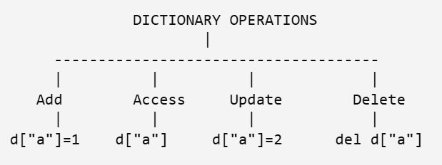
DICTIONARIES OPERATIONS
-> Accessing : values can be retrieved using their keys.
-> Adding : New key-value pairs can be added.
-> Updating : Existing values can be changed.
-> Removing : Key-value pairs can be deleted.
-> Checking : We can check whether a particular key exists in a dictionary

Slide 15
Methods & Applications
-> Provides fast access to data using keys
-> Makes data easy to organize and understand.
-> Allows data to be modified easily.
-> It can store different types of values.
-> Useful for representing structured information.
-> keys() - returns all the keys.
-> values() - returns all the values.
-> items() - returns all the key-value pairs.
-> get() - safely retrieves a value.
-> update() - adds or modifies key-value pairs.
-> pop() - removes a specified key-values pair

Slide 16
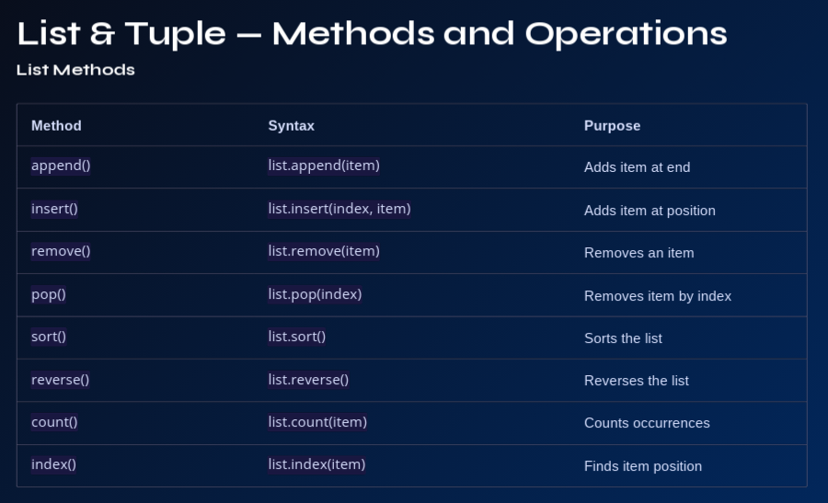

Slide 17
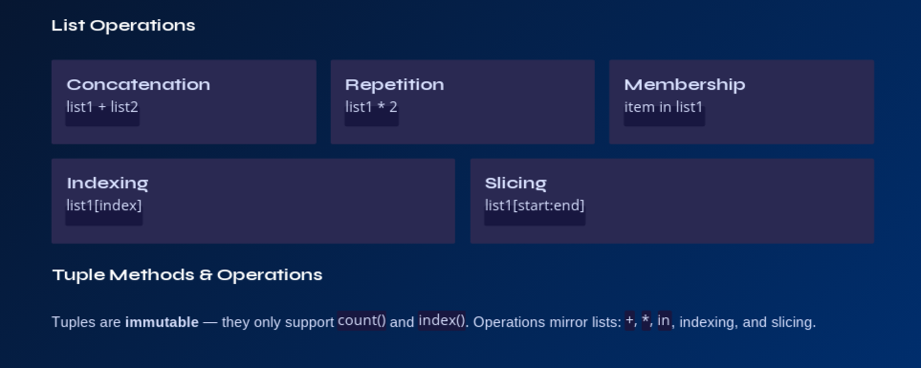

Slide 18
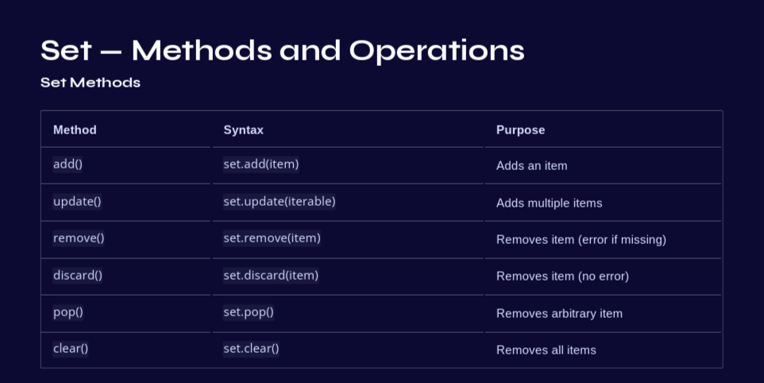

Slide 19
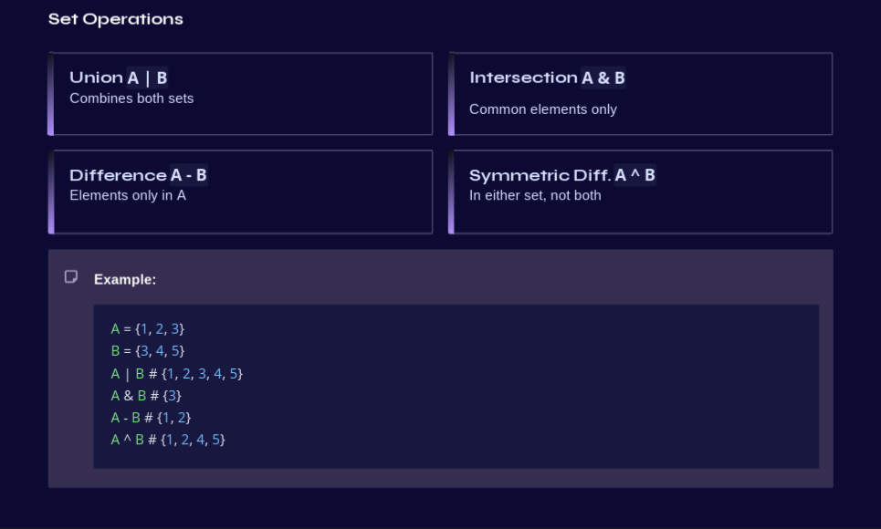

Slide 20
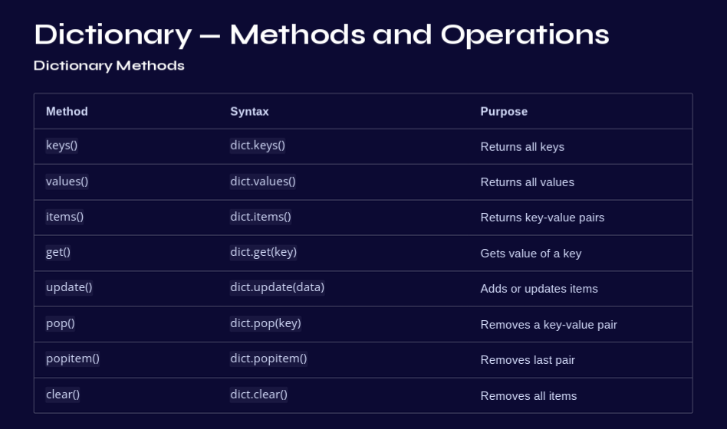

Slide 21
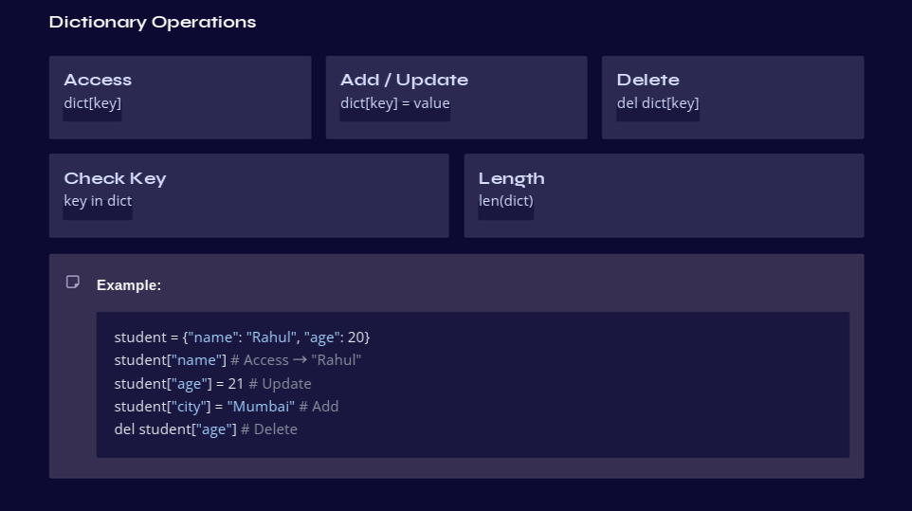

Slide 22
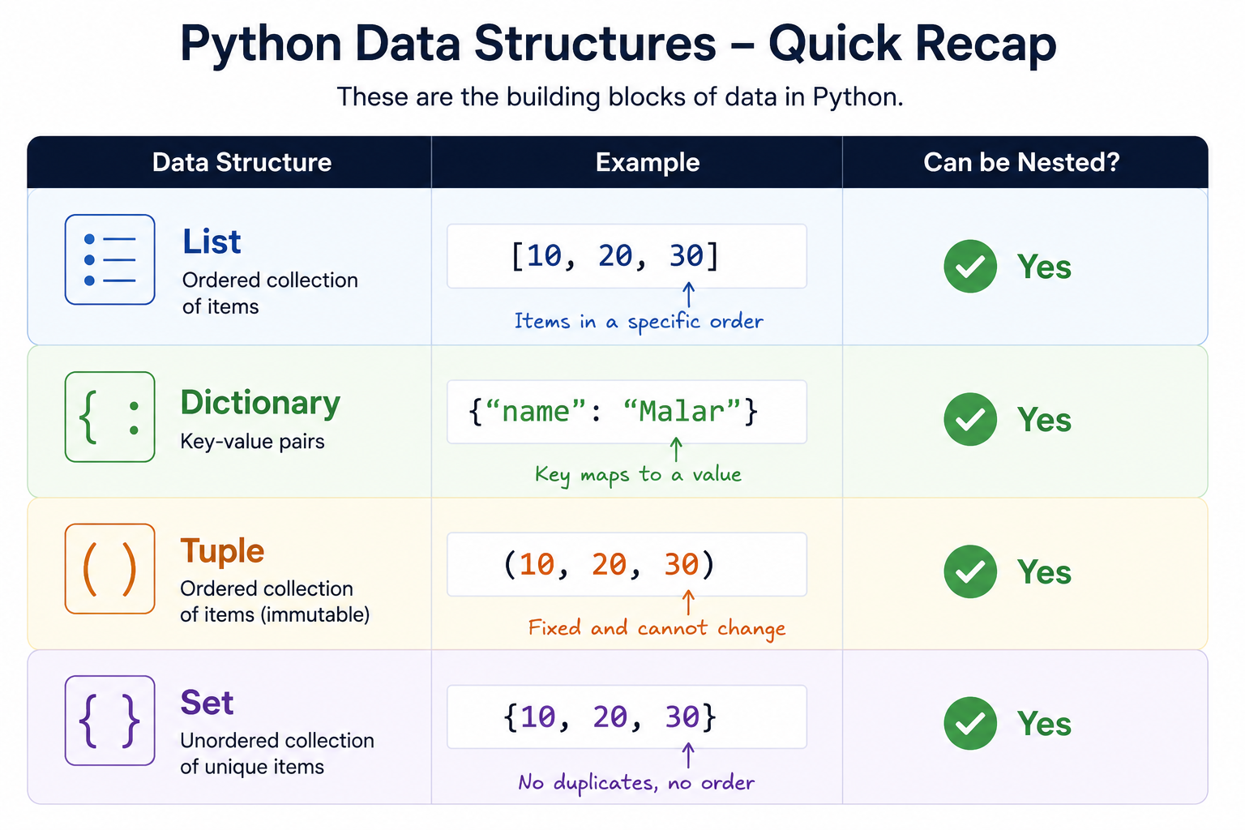
Things Inside Things?!
NESTED DATA STRUCTURES
Imagine a student record containing:
Personal details
Courses
Scores
Instead of keeping everything separately: LIST
↓
DICTIONARY — Student
↓
DICTIONARY — Courses
↓
KEY + VALUE — "SQL": 88
When one data structure contains another data structure inside it.

Slide 23
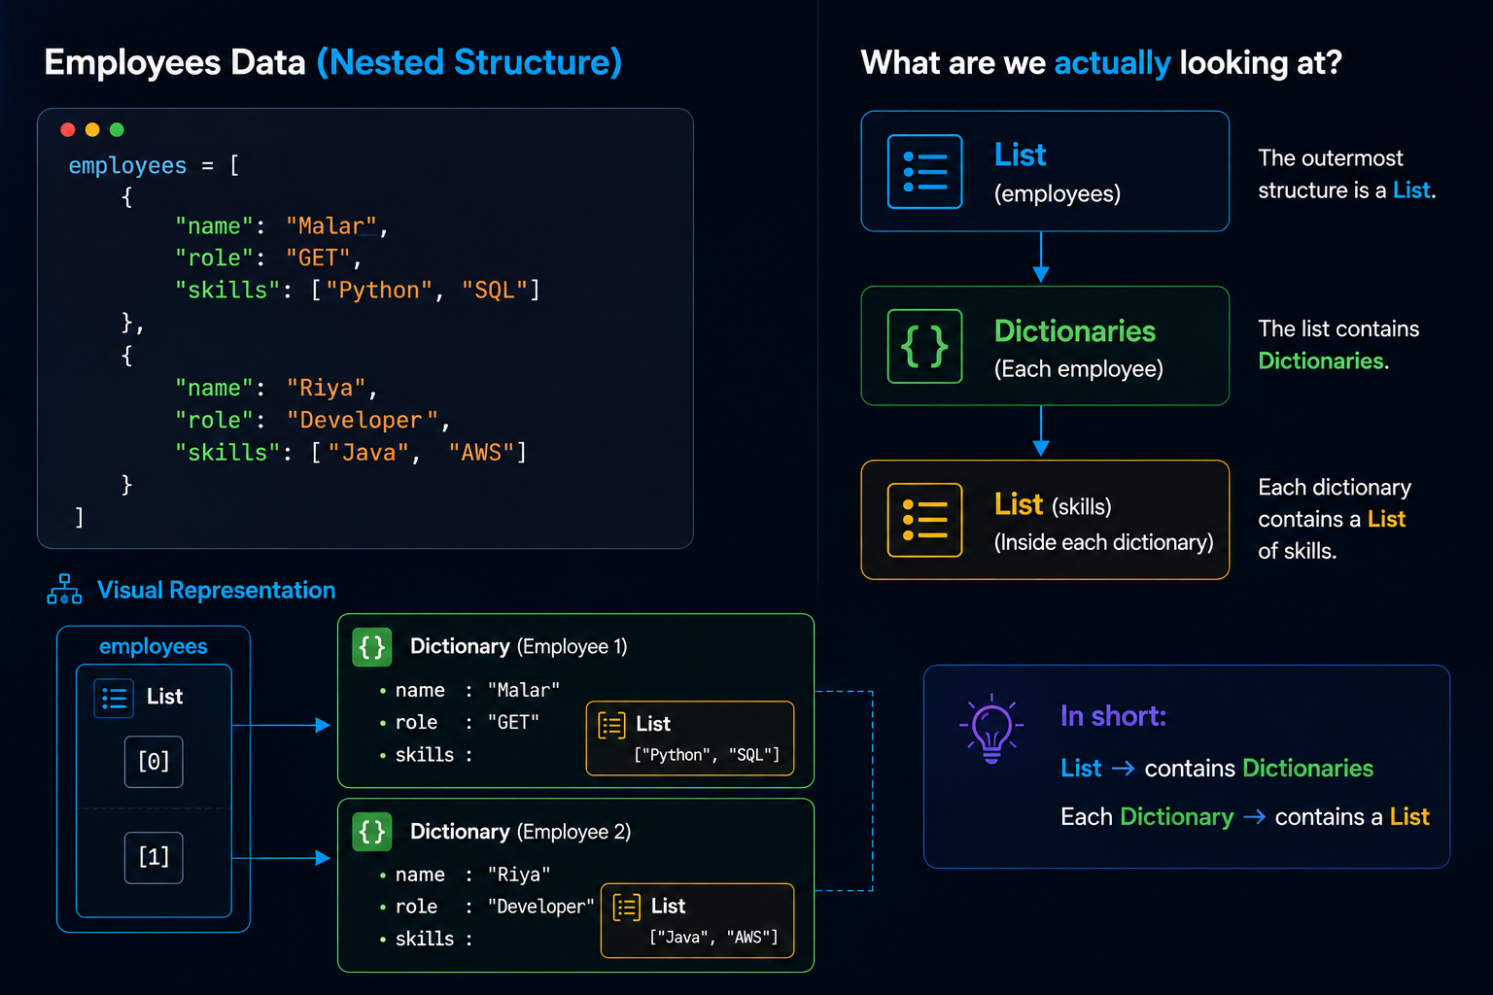

Slide 24

Nested Challenge: Can You Trace the Data?
students = [
{
"name": "Arjun",
"courses": [
{"name": "Python", "score": 92},
{"name": "SQL", "score": 88}
]
},
{
"name": "Riya",
"courses": [
{"name": "Python", "score": 85},
{"name": "SQL", "score": 91}
]
}
]
1. What will this return?
students[1]["courses"][0]["score"]
A) 88
B) 85
C) 91
D) Python
2. How would you access Riya's SQL score?

Slide 25
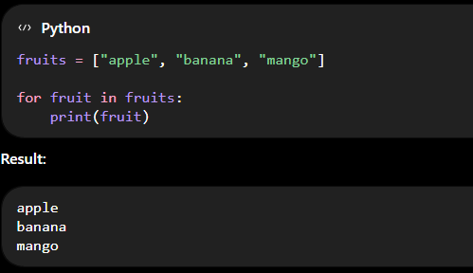
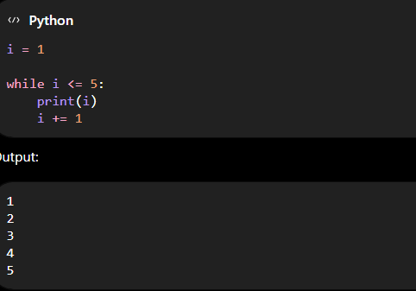
ITERATION AND MANIPULATION
Iteration means repeating a set of instructions, usually using loops
and the loop changes checking if the condition is being given or not.
Python mainly has two types of loops:
for loop → repeat for each item in a sequence
while loop → repeat while a condition is true

Slide 26
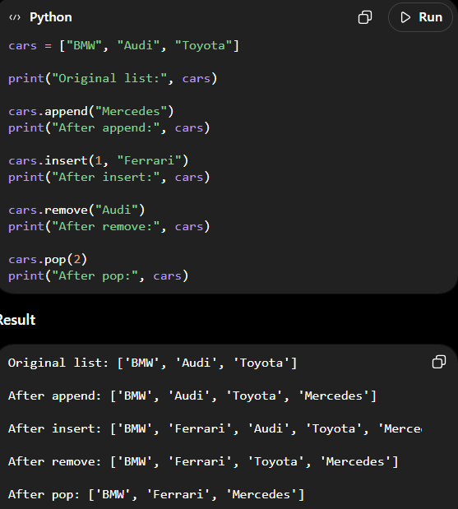
MANIPULATION
Manipulation means changing, modifying, adding, removing, or rearranging data.
The functions used to manipulate are
append( ) - This adds a additional value in the list
insert( )- This adds a value but at the designated
place we allot
remove( ) - This removes the value
pop( ) - This helps in the removing the value with the position value

Slide 27
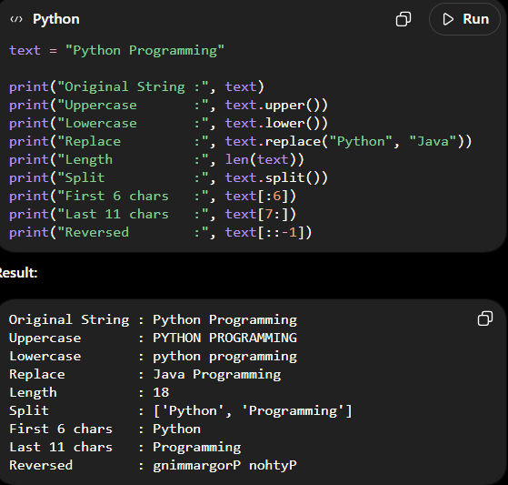
STRING MANIPULATION
The string values can be manipulated
The functions used in the string manipulation are:
upper( ) - converts the string to uppercase
lower( ) - converts the string to lowercase
replace( ) - this is used to replace one word with another
split ( ) - this is used to split the string based on the criteria given

Slide 28
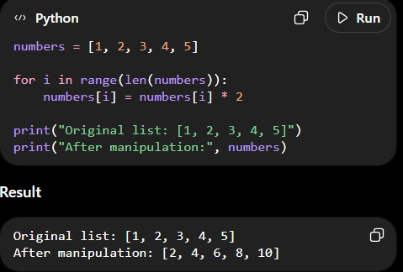
ITERATION AND MANIPULATION
The manipulation happens in the list and
then the iteration happens from the 1st till
the end of the list.
Manipulation
Iteration
Values gets printed

